Slide 1
CSE 320 Final Project FPGA Audio Recorder
Group #14
Jack Allen
Jonathan Cahal
Aashik Dhilipkumar

Slide 2
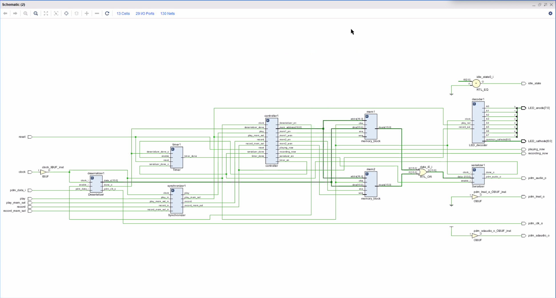
System Block Diagram

Slide 3
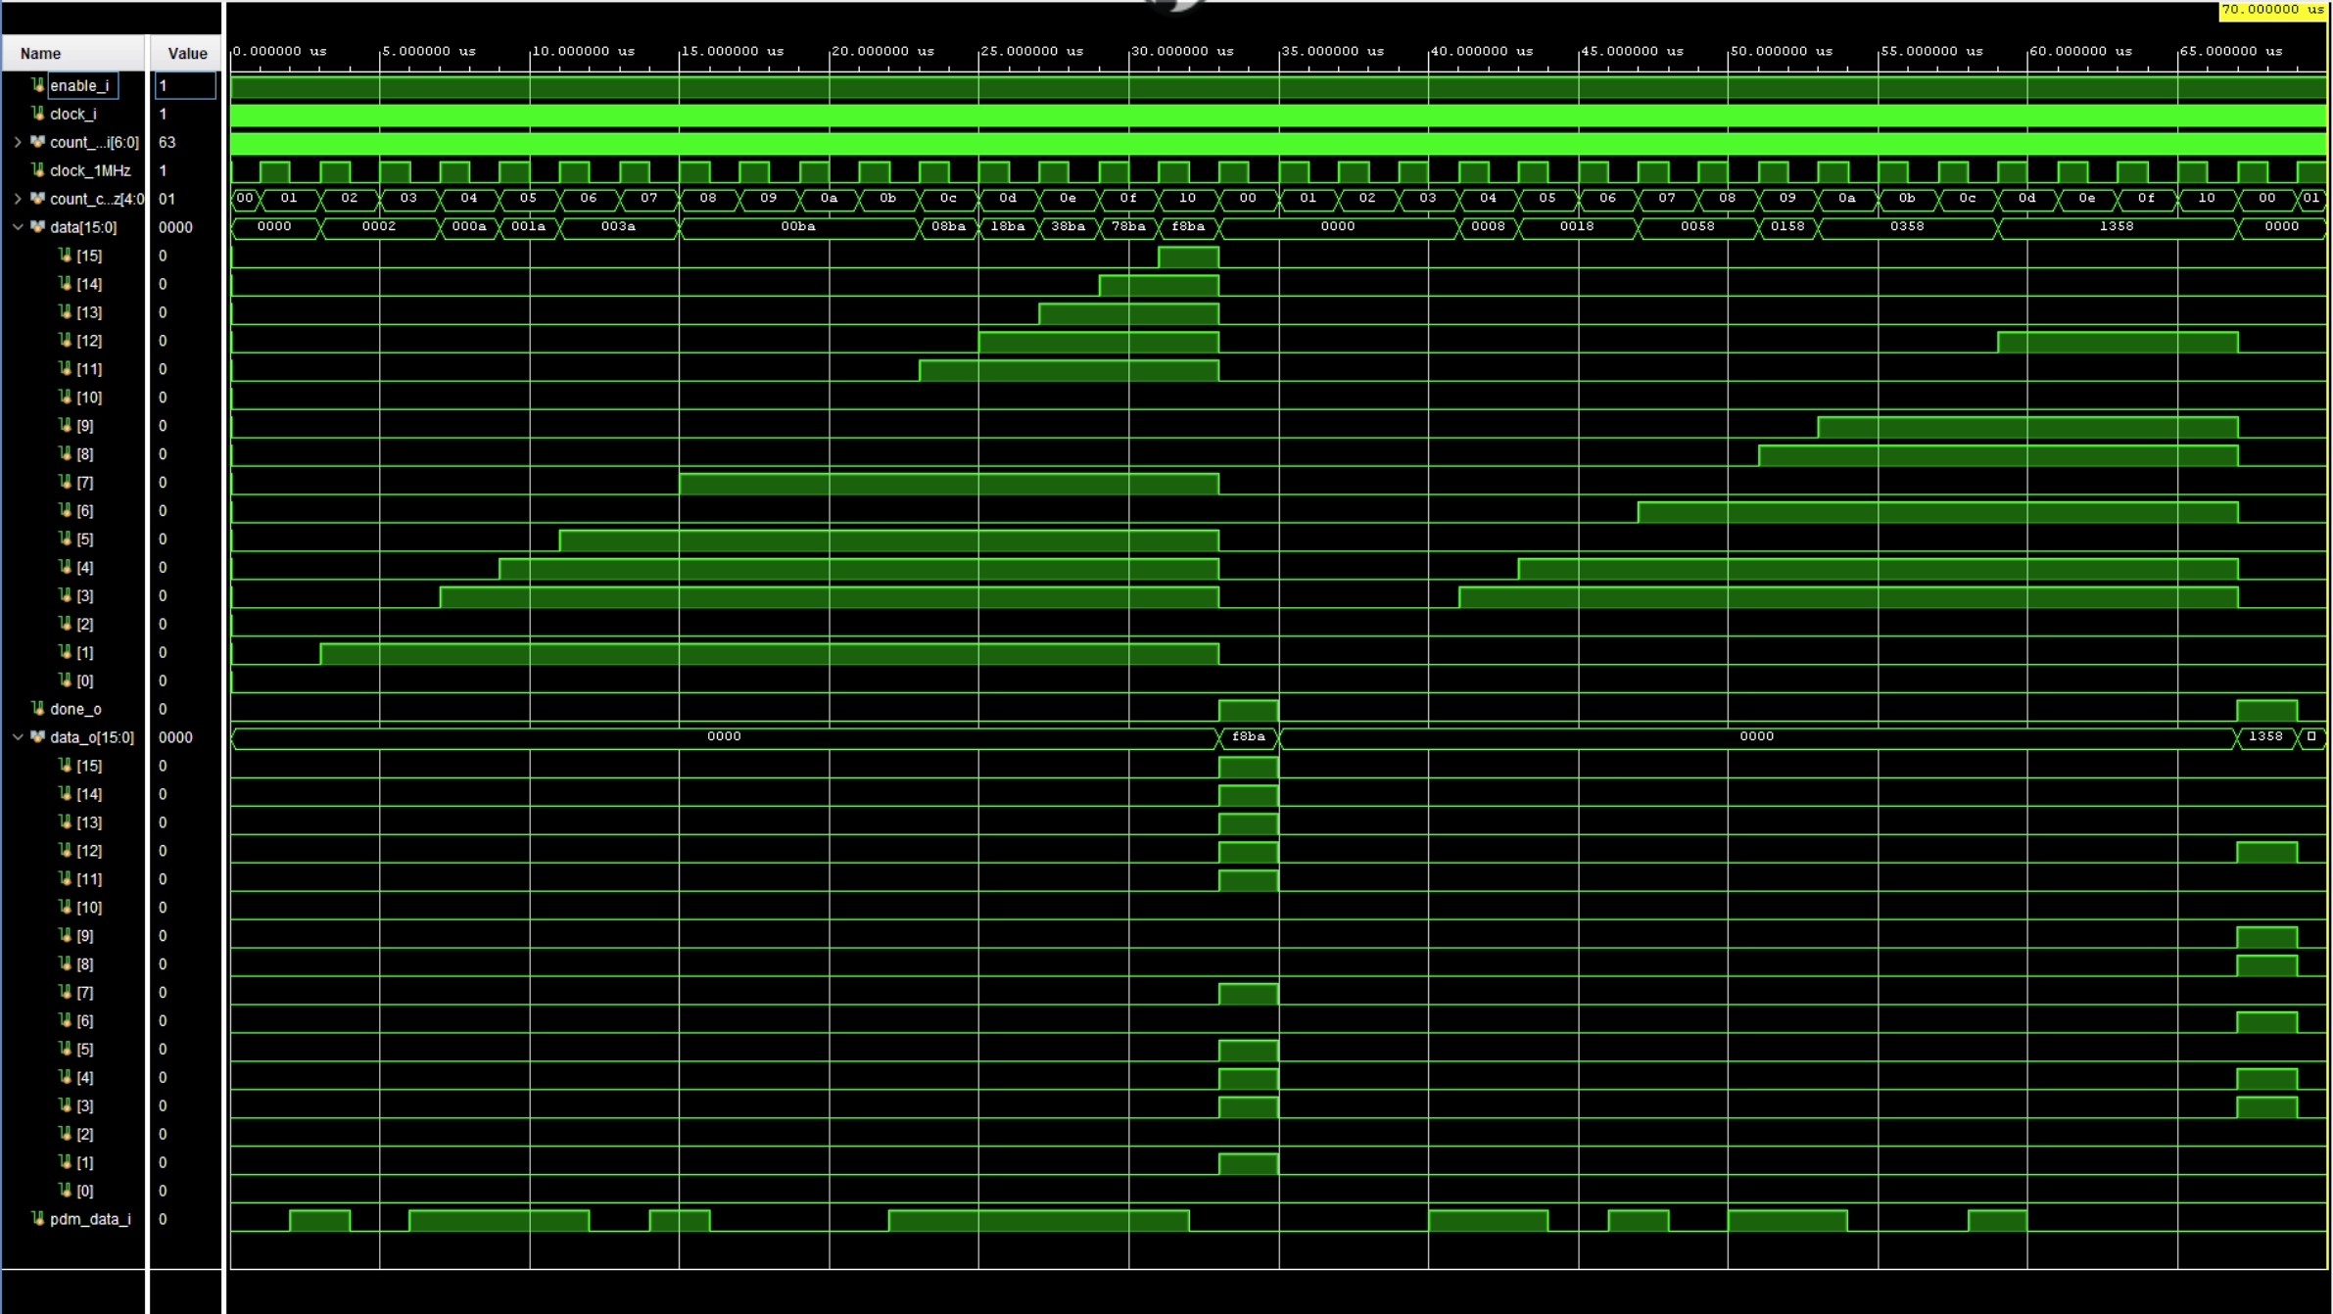
Deserializer

Slide 4
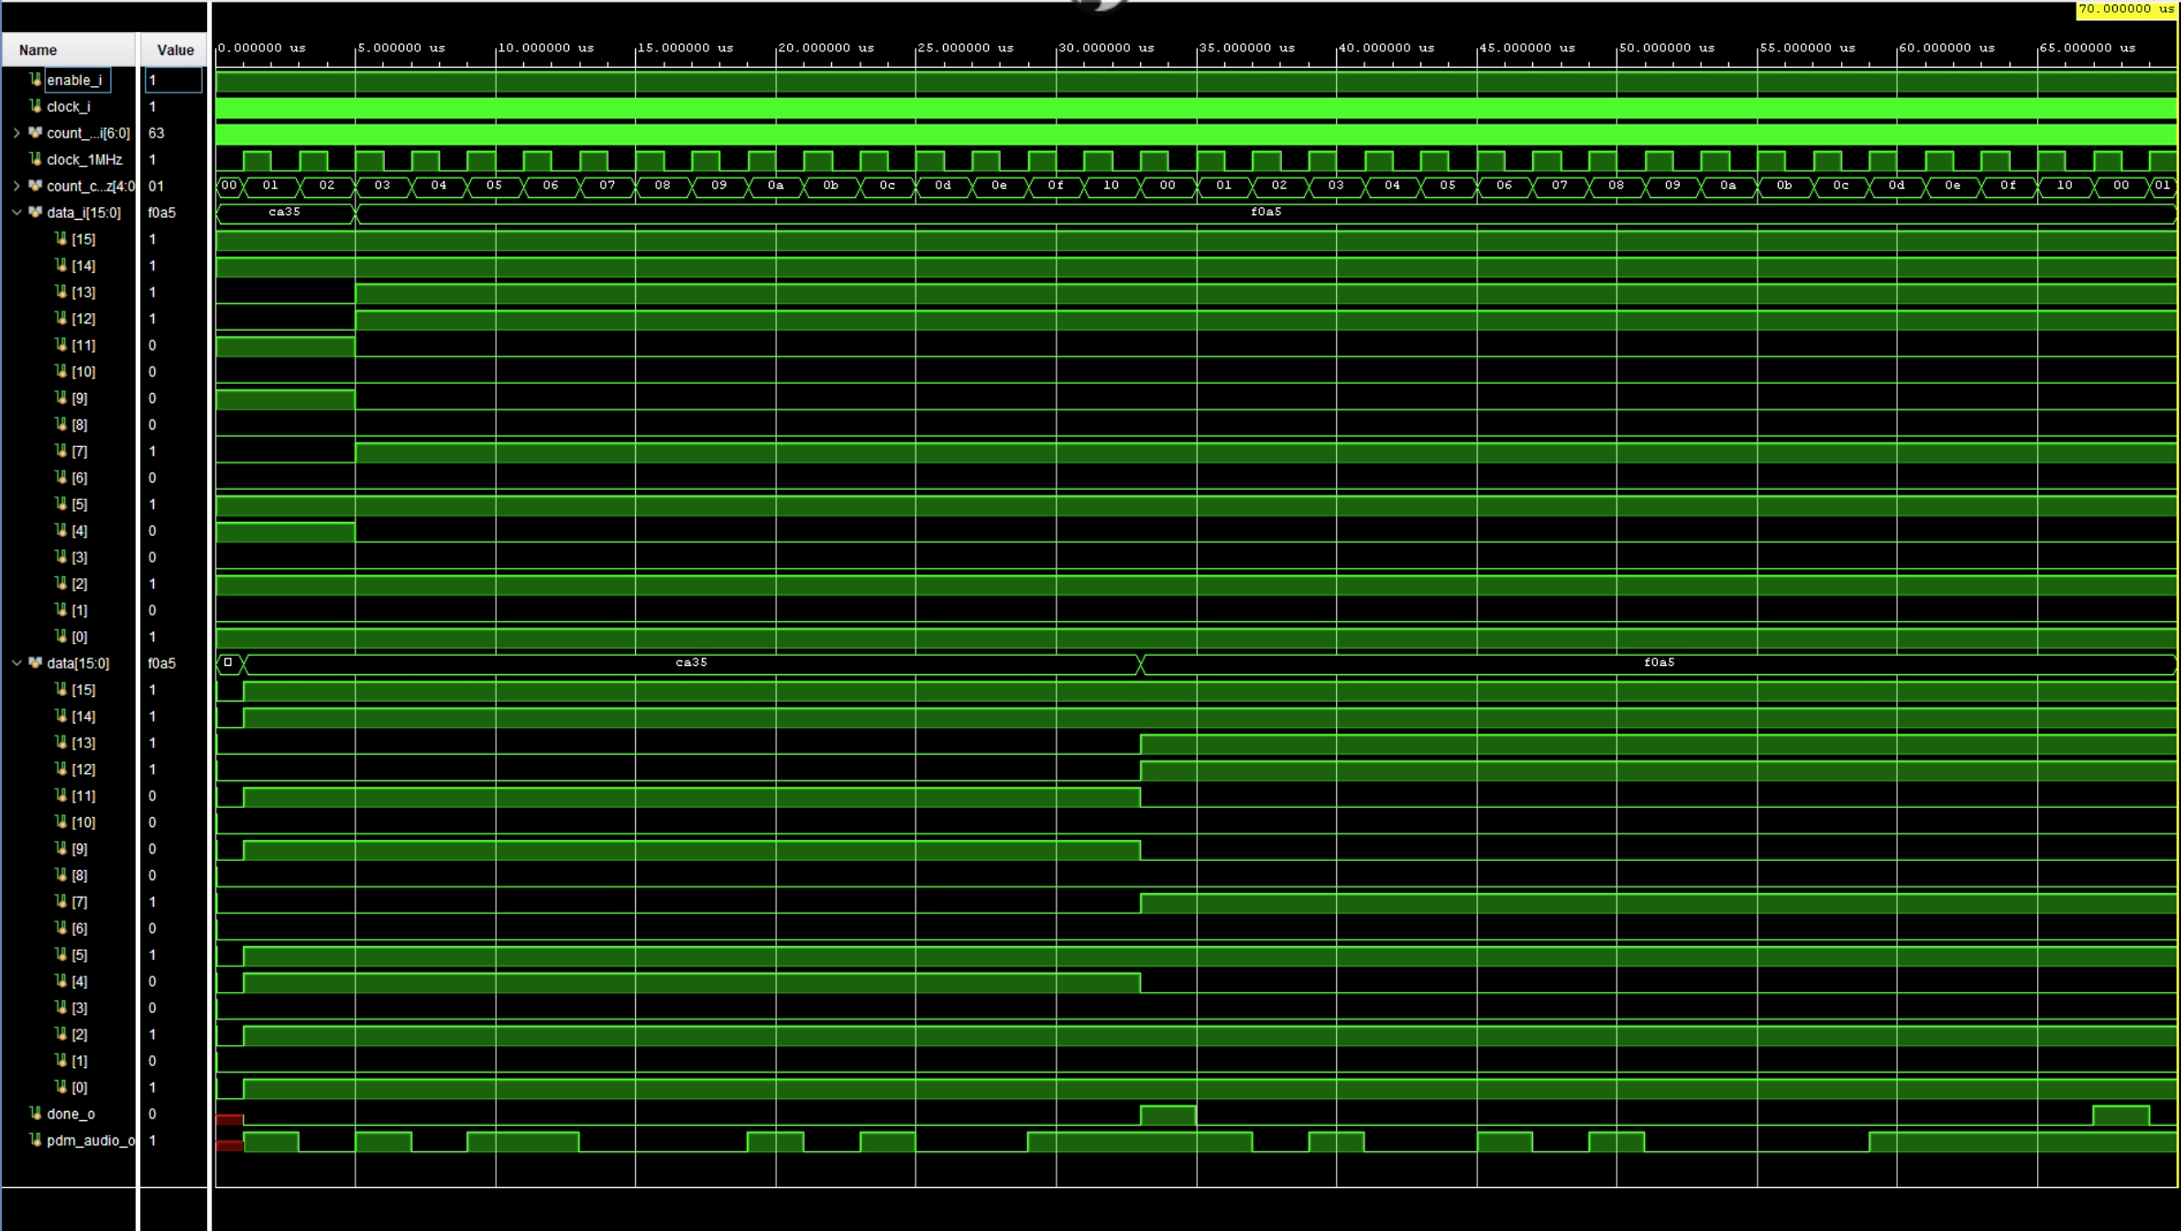
Serializer

Slide 5
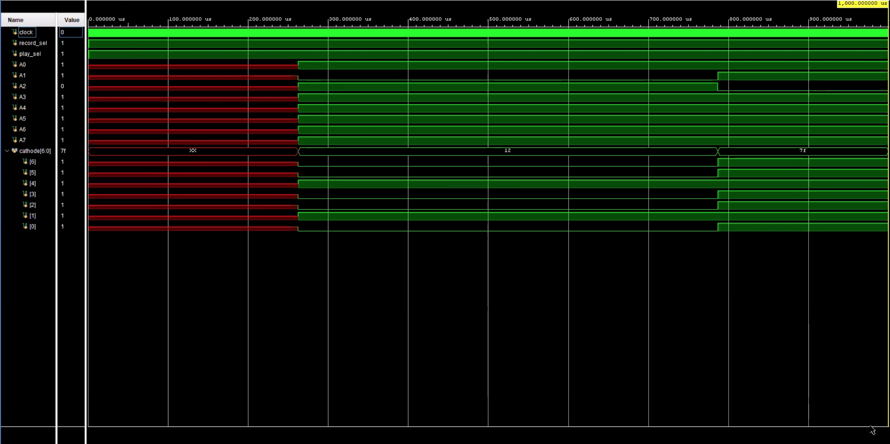
Seven-Segment LED Driver

Slide 6
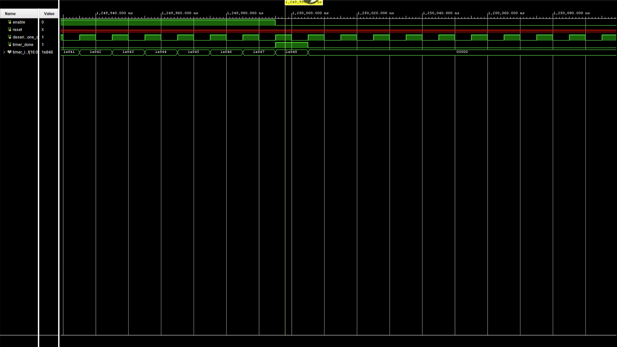
Timer

Slide 7
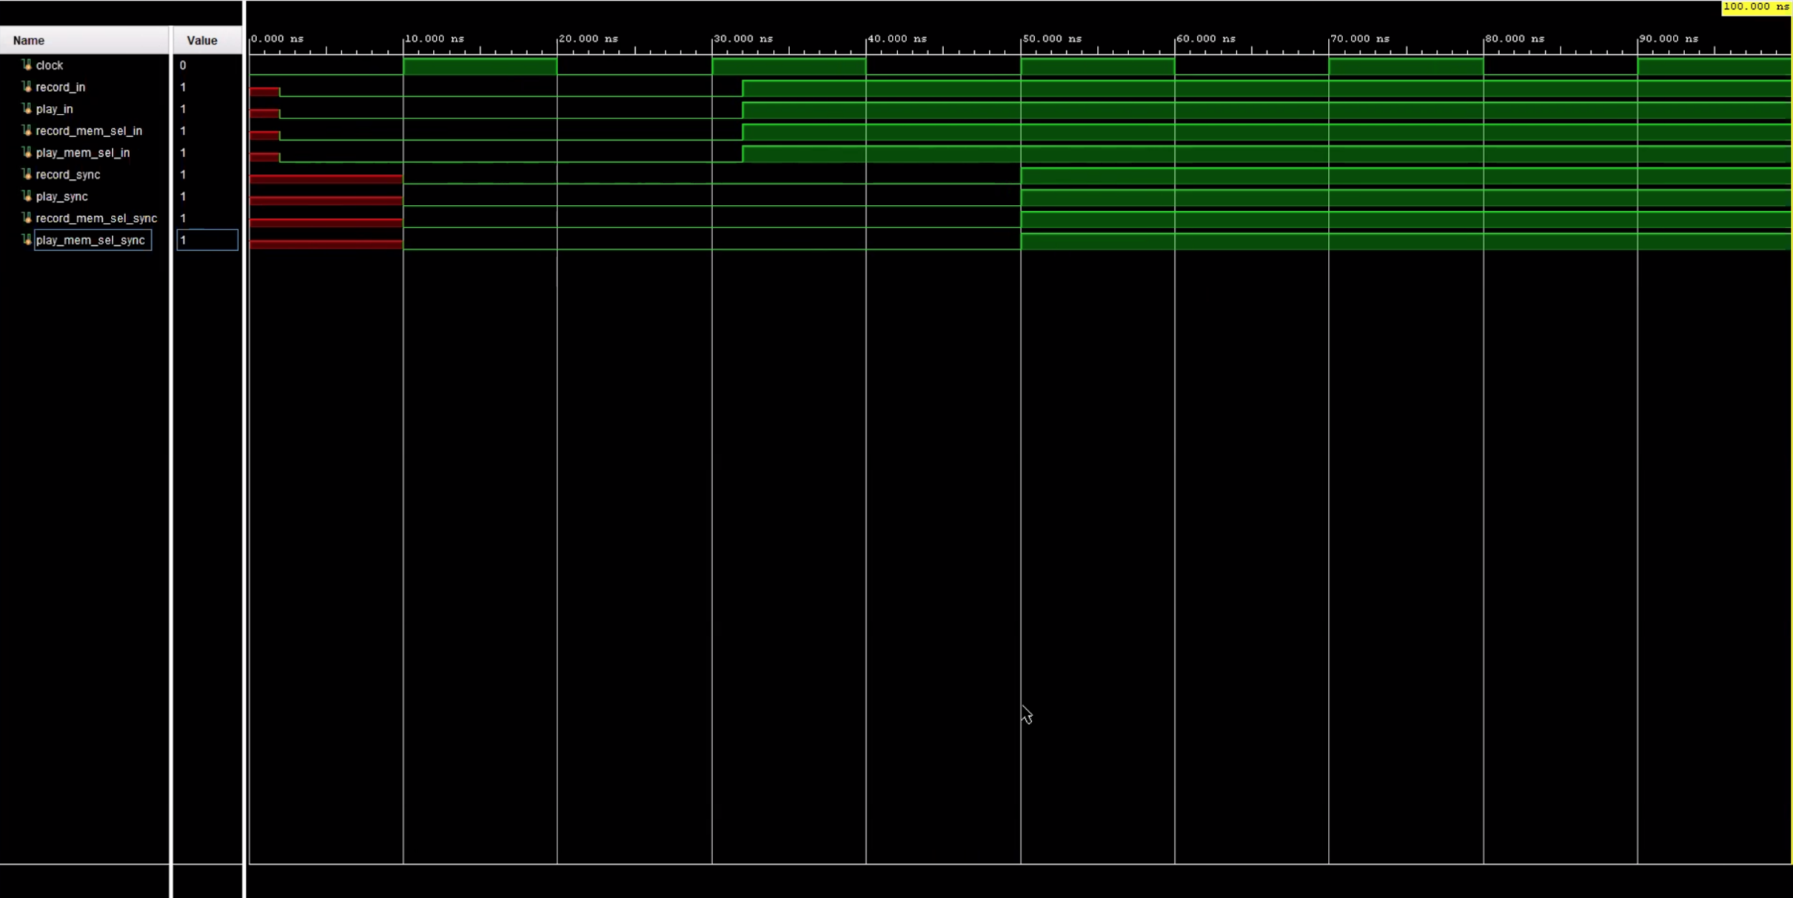
Synchronizer

Slide 8
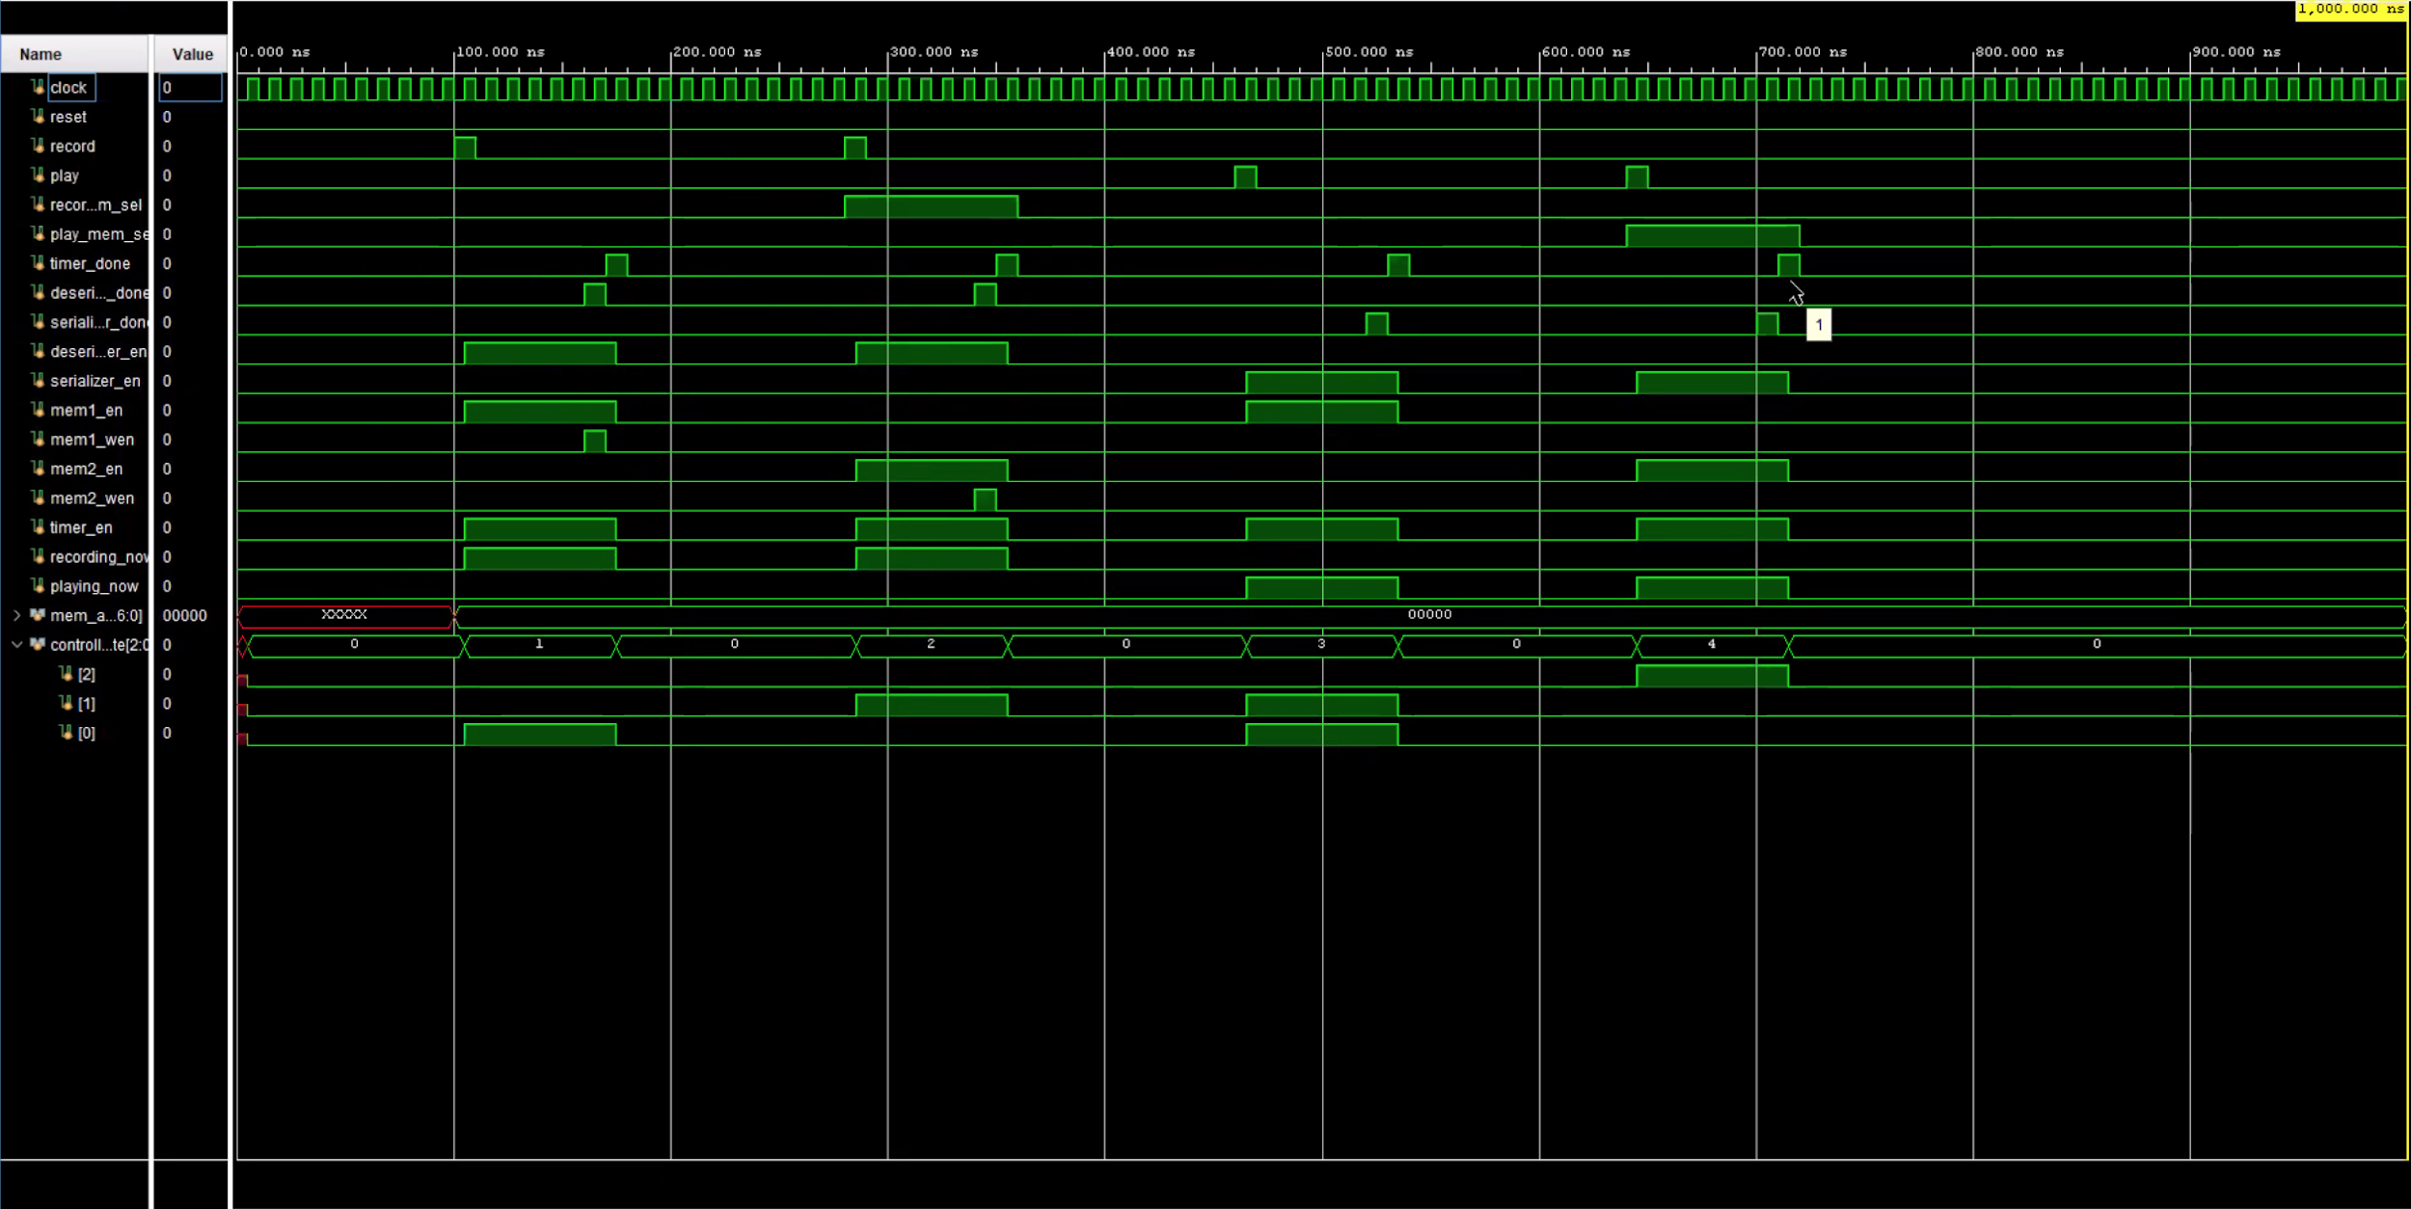
Controller

Slide 9
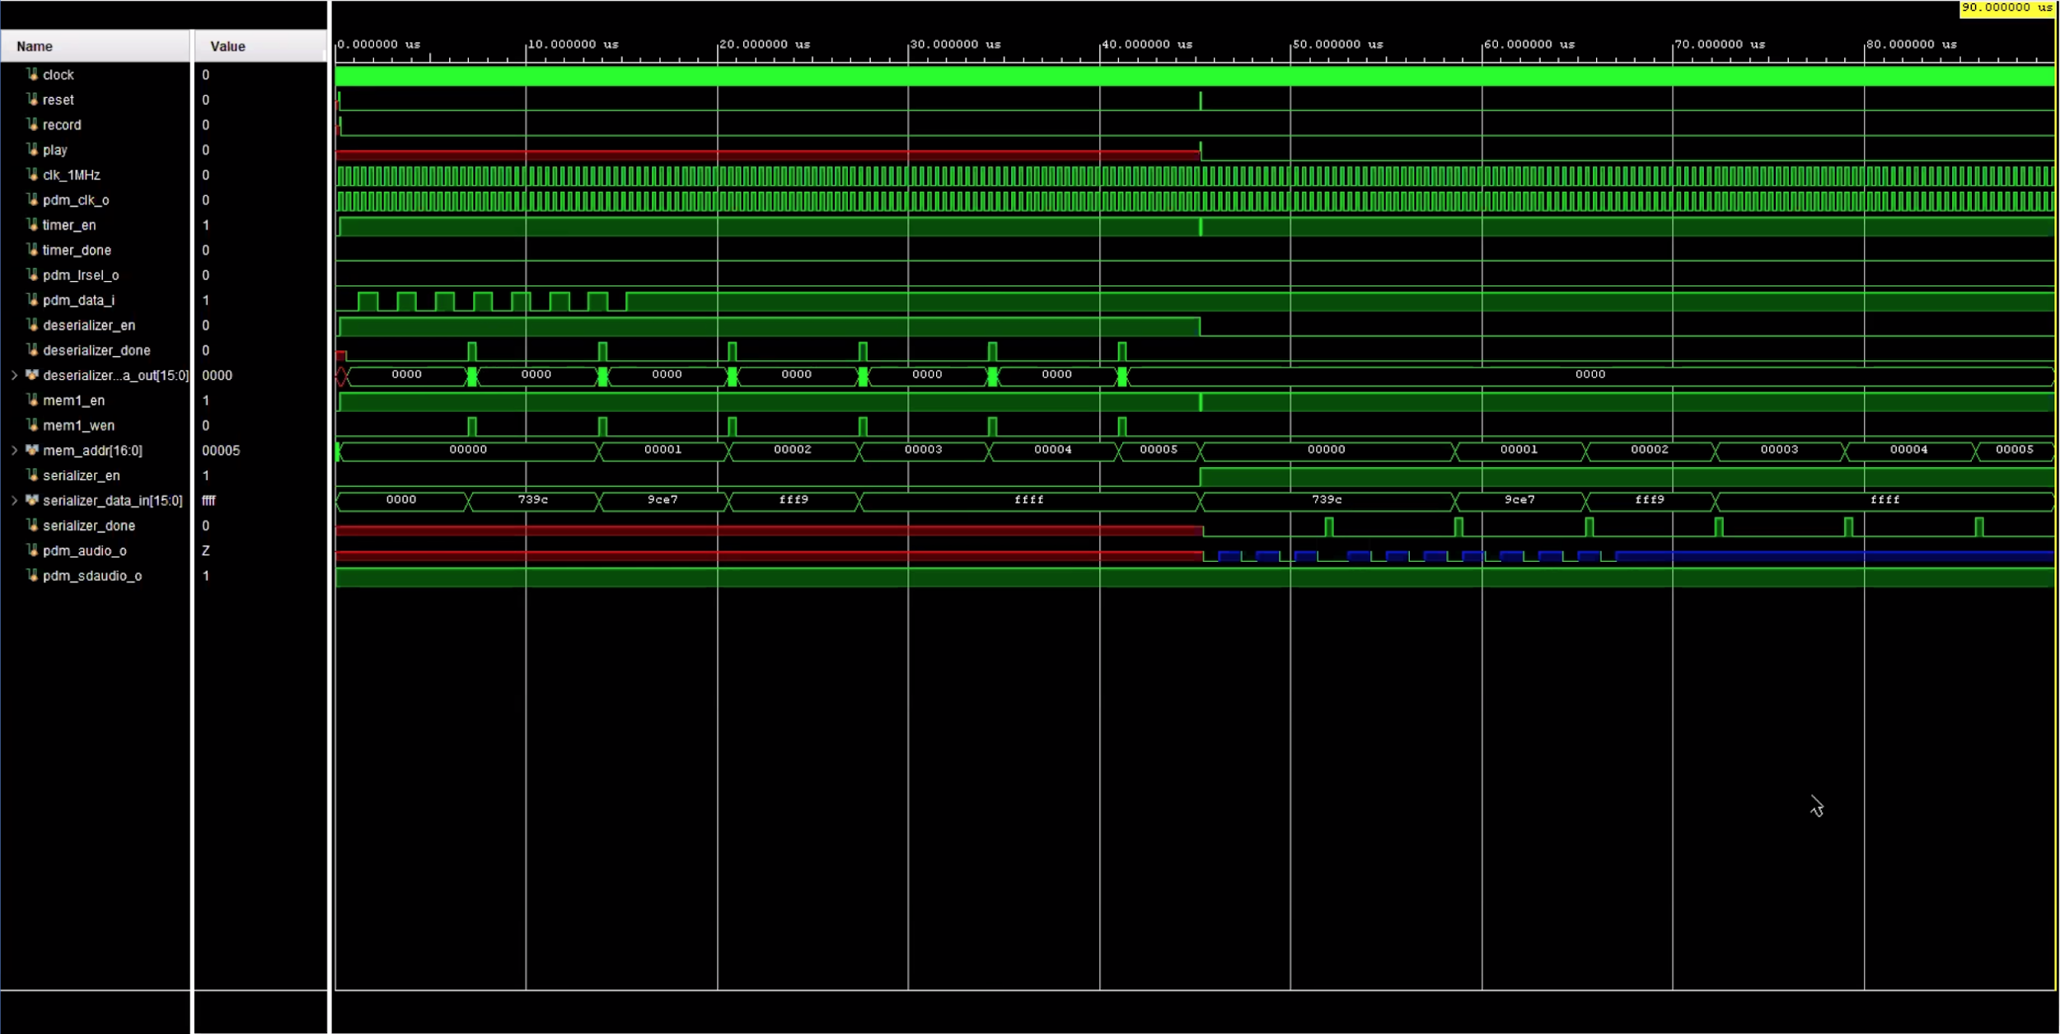
Data I/O Behavioural Wave Form

Slide 10
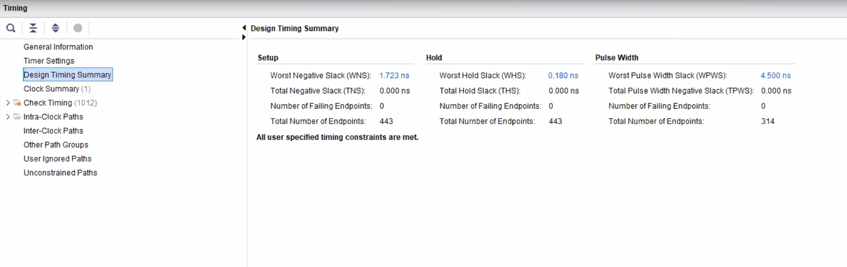
Timing Analysis: Max clk Frequency is 120.82MHz
Fmax = 1/(Actual Period - WNS) = 120.82 MHz

Slide 11
Bonus Features Implemented
List the bonus features that you have successfully implemented if any. Otherwise, enter “None”.

